Slide 1
The History of the Internet and Intro to ICANN

Slide 2
1. The History of the Internet
2.Get to know ICANN
3. Discussion

Slide 3
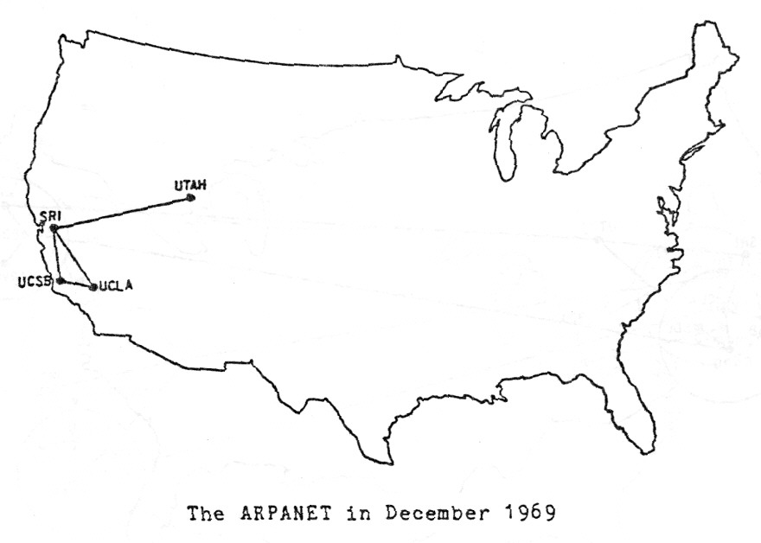
ARPANET

Slide 4
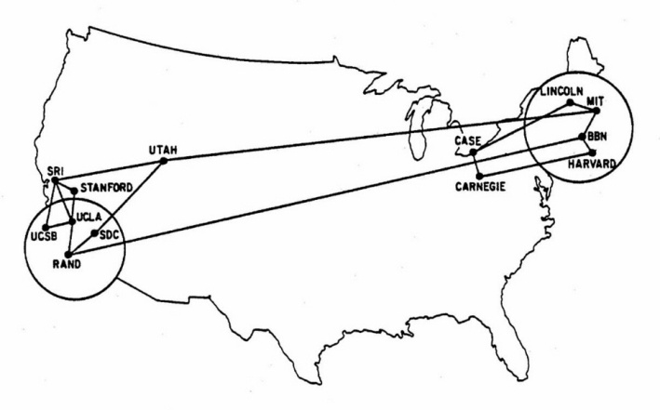
At the close of 1970 ARPANET had 13 nodes

Slide 5
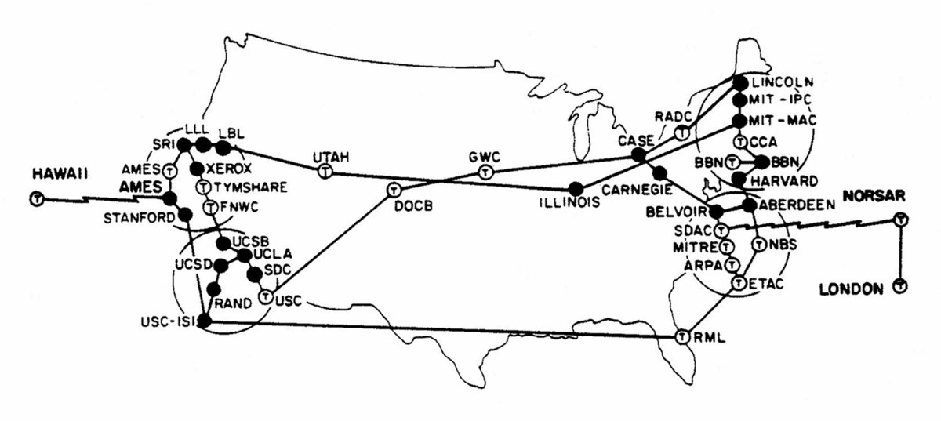
In 1973 ARPANET had 40 nodes

Slide 6

In 1971 engineer Ray Tomlinson invented email and ‘@’ symbol

Slide 7
File Transfer protocol

Slide 8
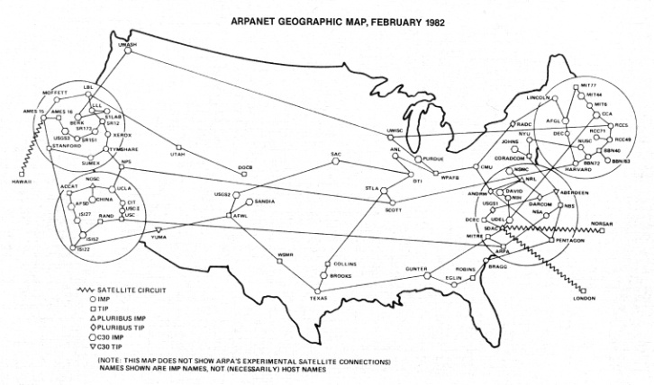
1980 the major application of ARPANET with 100 nodes

Slide 9
In 1980 USENET
Tom Truscott Jim Ellis

Slide 10

1982
1982

Slide 11
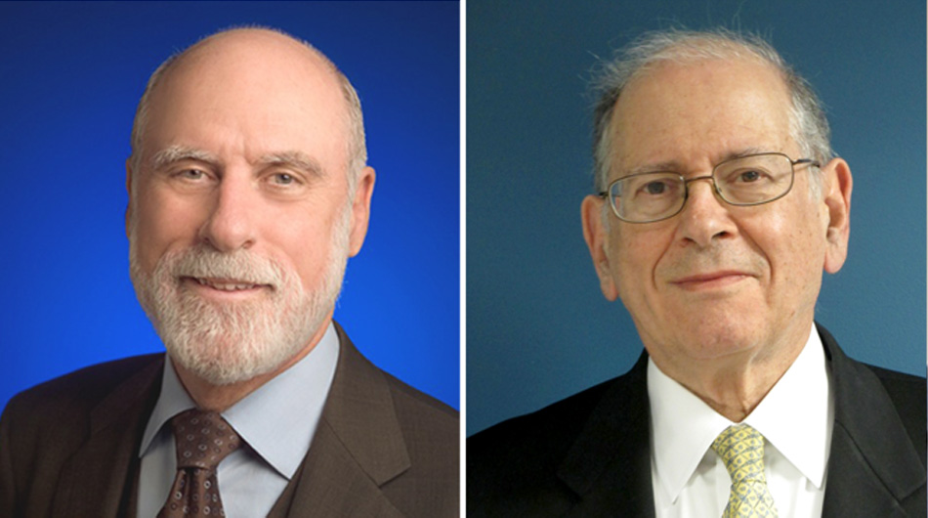
Vint Cerf & Bob Kahn

Slide 12
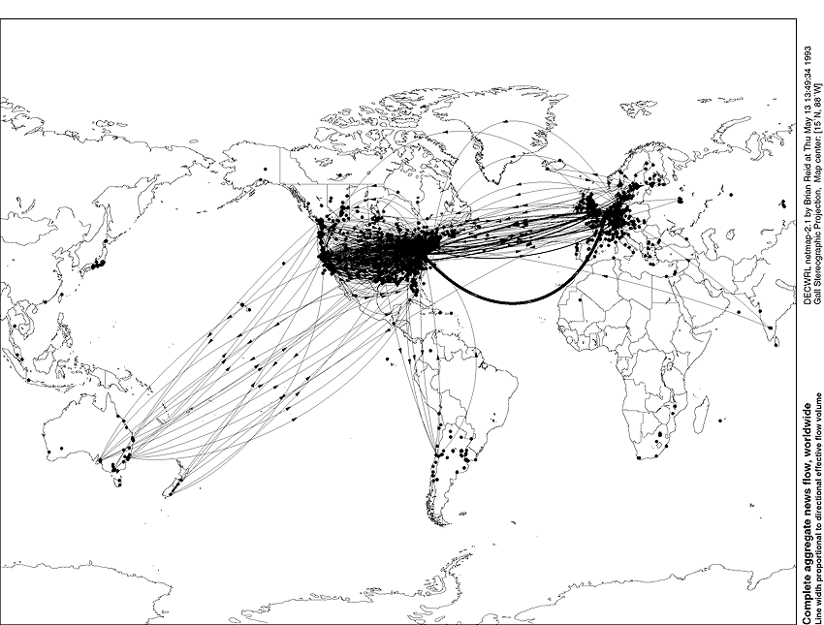
1993, the Internet went global

Slide 13
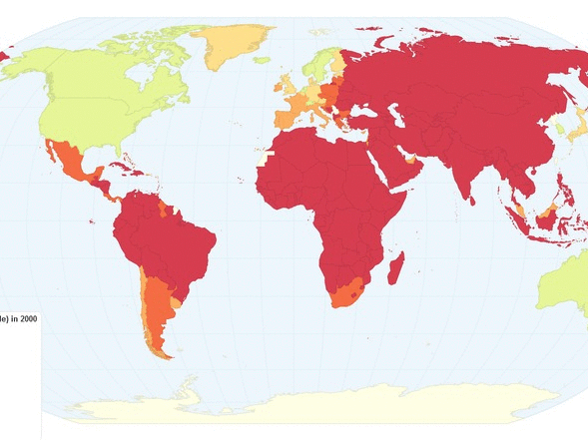
2000s nearly half of the Americans were online
2000s half of the Americans were online

Slide 14

2000s-less than 400 million Internet Users
Today-more than 3.5 billion Internet Users

Slide 15
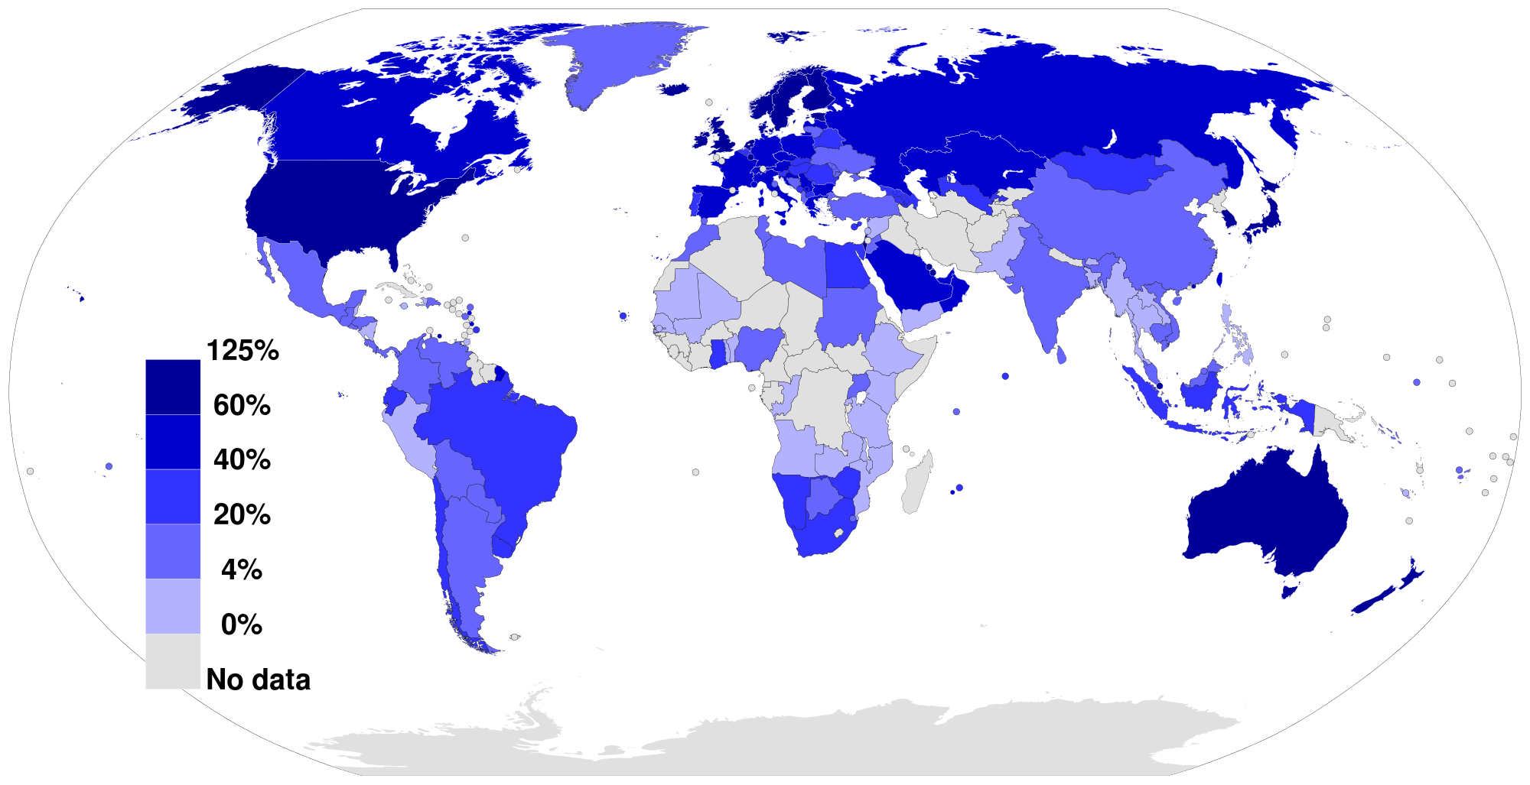
Mobile Penetration

Slide 16
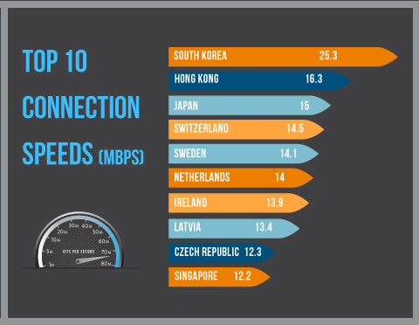
Where are Internet connections the fastest?

Slide 17
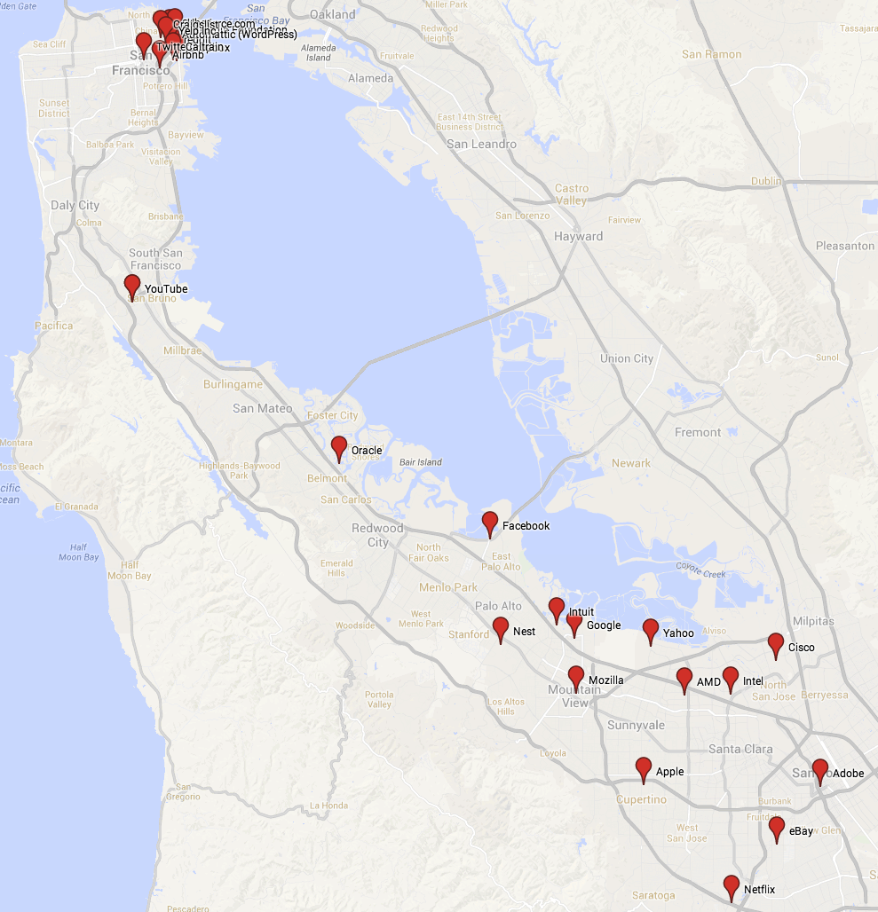
Walkthrough of Key Locations

Slide 18
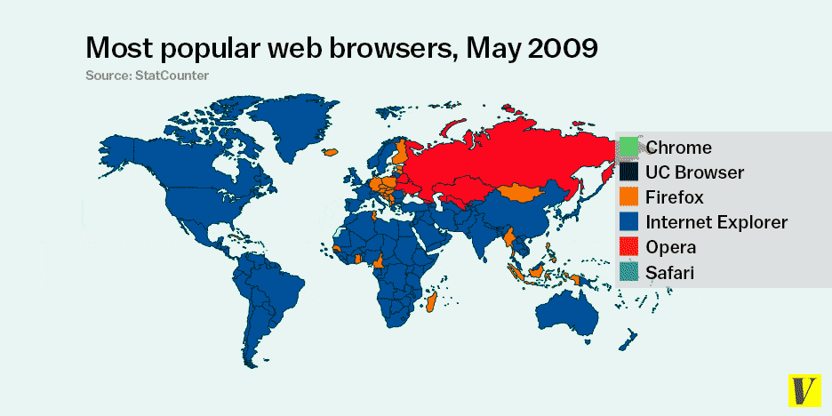
Web Browsers’ popularity

Slide 19

2009-Internet Explorer&Opera

Slide 20

2010-2011
Internet Explorer &Firefox

Slide 21

2012-Chrome

Slide 22
2013-2014-up to now
The world mainly Chromenized

Slide 23

ARMENIAPEDIA

Slide 24
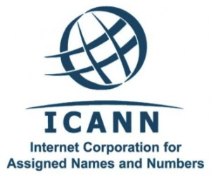

Slide 25
https://www.youtube.com/watch?v=IJY5xJKPhjA

Slide 26
1.ICANN was formed in 1998
2.Not-for-profit public-benefit corporation
3.Multistakeholder approach
4.Consensus-driven policy making
5.Top-down governance model

Slide 27
Getting Started with ICANN Learn
English
Russian
Spanish
French
Chinese
Arabic

Slide 28
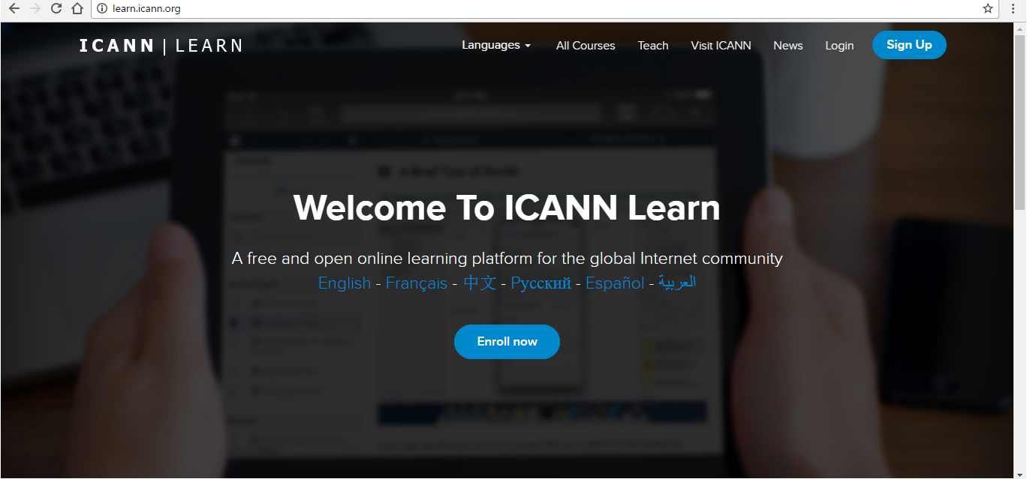
learn.icann.org

Slide 29
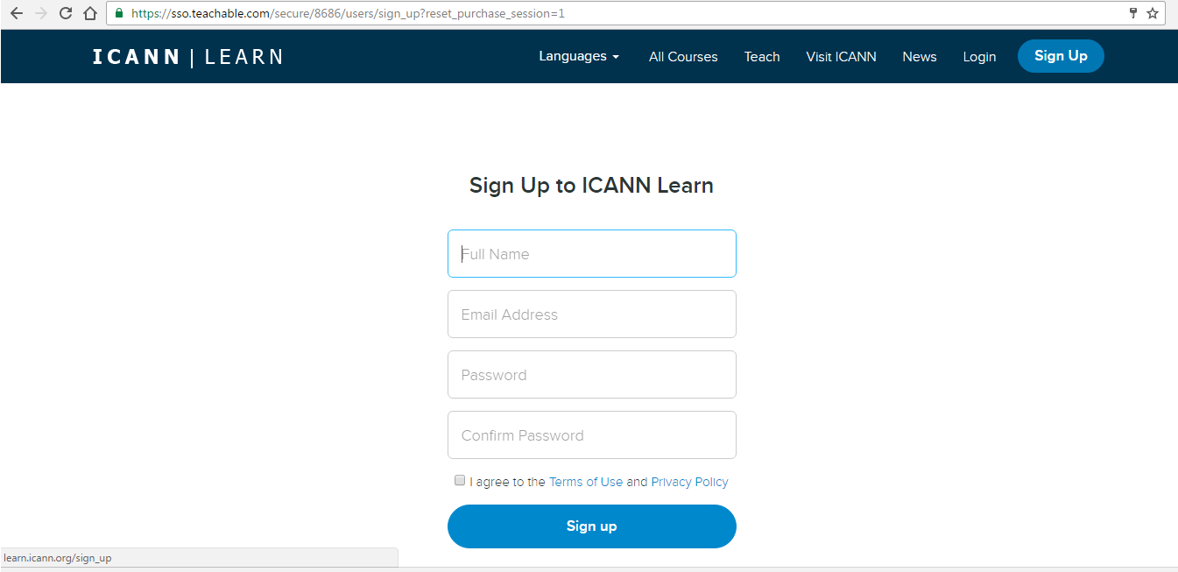
learn.icann.org

Slide 30
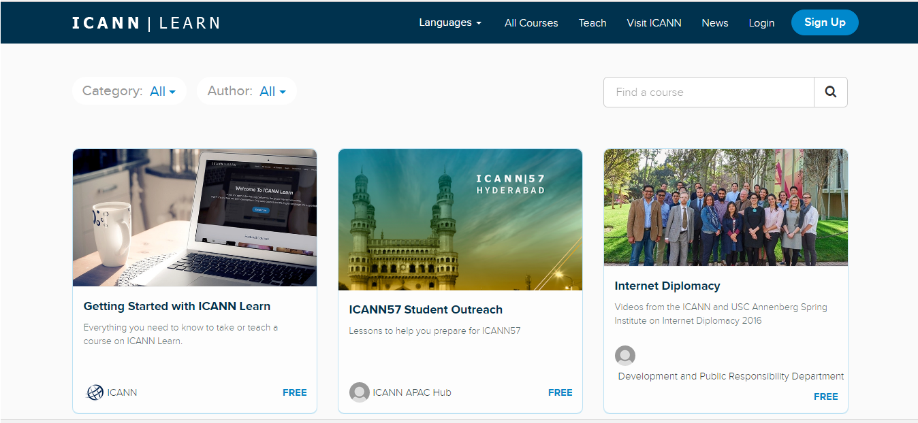
learn.icann.org

Slide 31
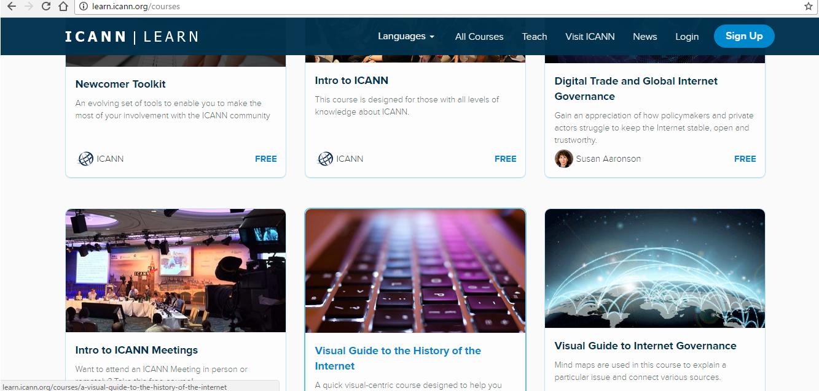
learn.icann.org

Slide 32
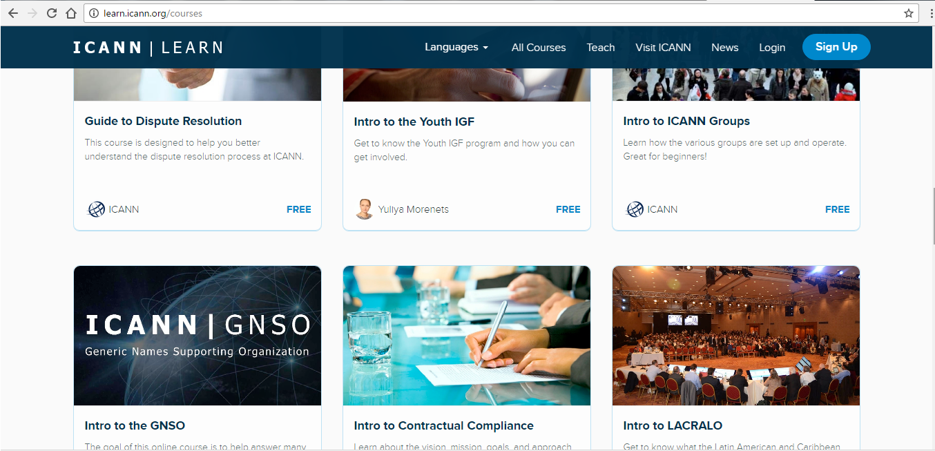
learn.icann.org

Slide 33
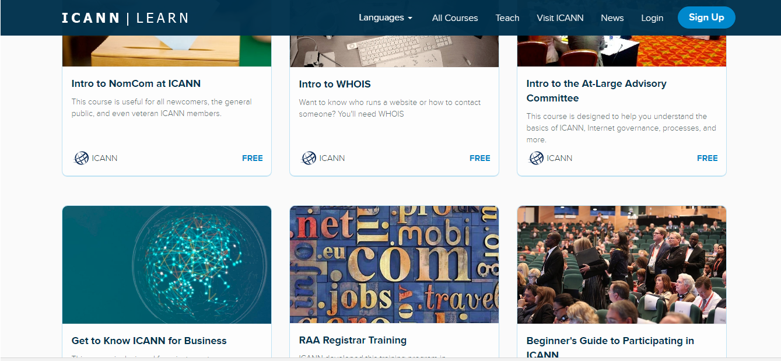
learn.icann.org

Slide 34
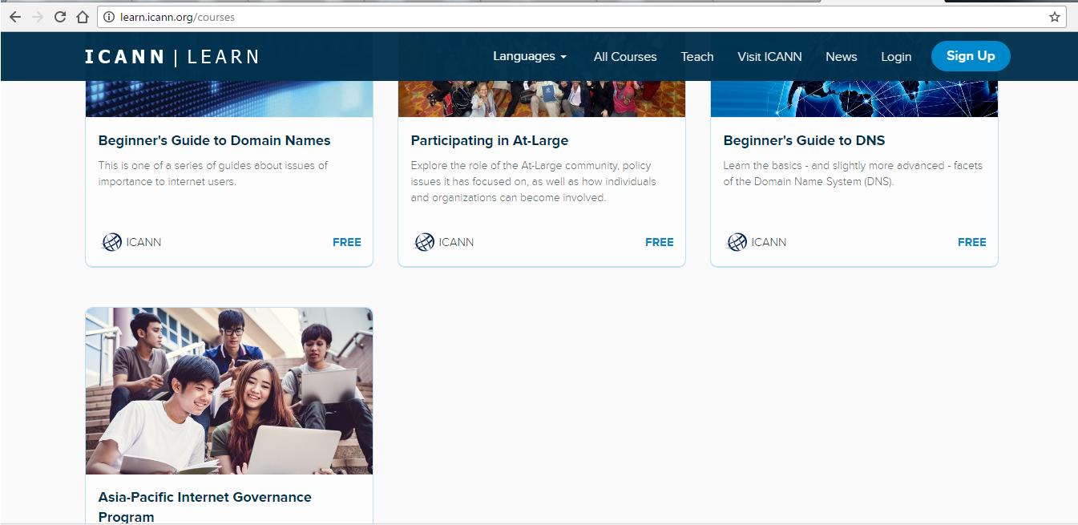
learn.icann.org

Slide 35
Board Of Directors
Supporting Organizations
Advisory Committees
Ombudsman
Nominating committee

Slide 36
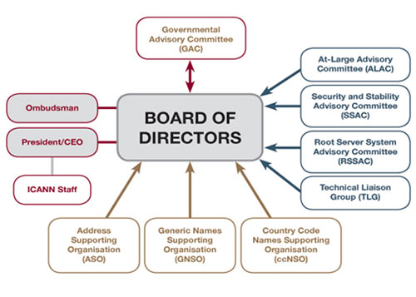

Slide 37

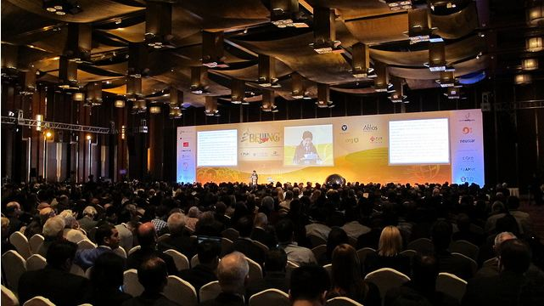

Slide 38
FINAL QUIZ

Slide 39
What does the acronym ICANN stand for?
1. Internet Corporation For Assigned Names and Numbers
2. Internet Company For Assigned Names and Numbers
3.International Corporation For Assigned Names and Numbers
4.Internet Corporation For Assigned Numbers and Names

Slide 40
When ICANN was formed?
1.1998
2.1982
3.1993
4.1969

Slide 41
Which body has the ultimate power to approve or reject policy recommendation?
1.Ombudsman
2.Supporting Organizations
3.The President of ICANN
4.Board of Directors

Slide 42
How many annual meeting does ICANN organize?
1.3 meetings
2.3 meetings every 3 months
3.4 meetings
4.1 general meeting

Slide 43
What is one of the main functions of ICANN
1.Ensure a stable and unified global Internet
2.Stop spam and deal with access to the Internet
3.Sell and Resell Domain Names
4.All of the above mentioned

Slide 44
Who was the inventor of email and ‘@’ symbol?
1.Ray Tomlinson
2.Tom Truscott
3.Jim Elis
4.Vint Cerf’

Slide 45
Who are considered to be ‘fathers’ of the Internet?
1.Vint Cerf and Bob Kahn
2.Tom Truscott and Jim Elis
3.Ray Tomlinson and Bob Kahn
4.Vint Cerf and Jim Elis

Slide 46
THANK YOU

